Slide 1


Accessibility and Learning
A Presentation for EDID6510
By
Laura Taylor
Gaitree Boondoo
Arlyn Linton-Jones
Jazelle Jones

Slide 2
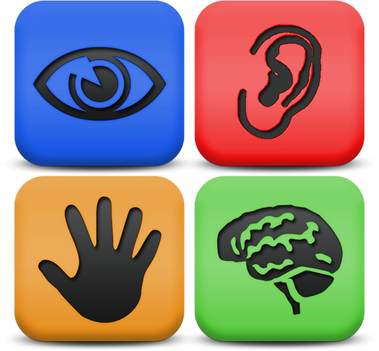
Web Accessibility
The unfettered access to information, resources, & multimedia artefacts that are found in web-based environments.
(World Wide Web Consortium (W3C), 2012).

Slide 3

Web Accessibility cont’d
Designing for current & future needs by “removing barriers to participation & engagement… and the degree to which someone can access an online resource regardless of their disability, technology or environment” (p. 9).Jane Seale, 2014
E-learning and Disability in Higher Education: Accessibility Research and Practice

Slide 4
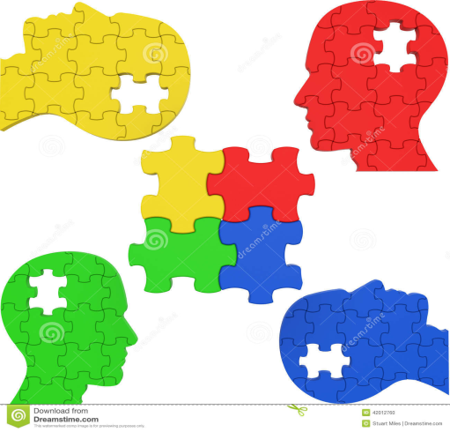
Web Accessibility Cont’d
Four important areas of consideration
Disability – temporary or permanent
Technology – a device, hardware, or software that facilitates web accessibility.
Environment - E-Learning and the LMS
Designing for current and future needs.

Slide 5




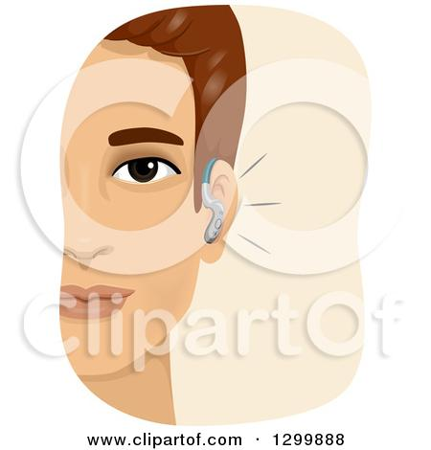
Web Accessibility Cont’d

Slide 6

Technology – Assistive Technologies
Increase, maintain, or improve functional ability
Screen readers (eg. JAWS, ReadPlease, or Window Eyes);
Voice dictation software (eg. Dragon Naturally Speaking)
Content magnifiers, or refreshable braille displays.
Standalone self-voicing browsers (eg. aiBrowser or HearSay) produces speech output

Slide 7

Technology - Other
Multimedia (text, audio and video formats) - may be enhanced with captions & transcripts, or inserting sign language during production.
Older computers, browsers or technology
Tablets, laptops, mobile devices

Slide 8

Environment – The LMS
Sometimes “the only tool given to students for communicating with peers and teachers and for accessing particular learning”
(Moreno et al., 2012, p. 200).
Must be compatible with a range of browsers, older technologies, learning objects and ATs to facilitate teaching/learning effectiveness.

Slide 9

Designing for Current & Future Needs
“Online content represents the next frontier for learning and lifelong education” (The Civil Rights Education and Enforcement Center, 2015).
Flexible Learning
Universal Access
Universal Design

Slide 10

Designing for Current & Future Needs
For persons with disabilities
For persons within varying situations such as different learning styles (eg. audio and visual learners), or slow internet connectivity
For everyone

Slide 11
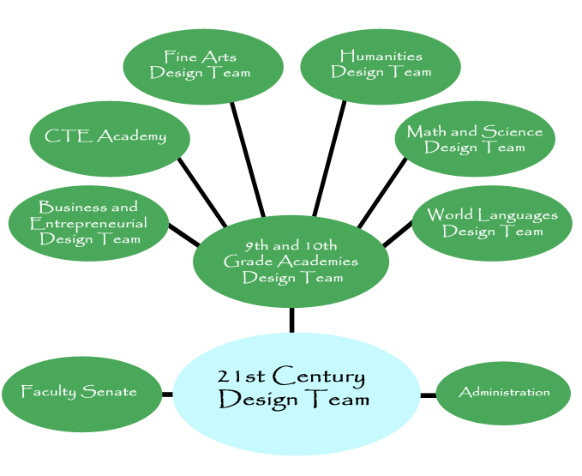
Design Principles
The Seven Principles of Universal Design :
Equitable Use
Flexibility in Use
Simple and Intuitive Use
Perceptible Information
Tolerance for Error
Low Physical Effort
Size and Space for Approach and Use(Dugger& Allen,2012)

Slide 12

Content Guidelines
Web Content Accessibility Guidelines 2.0:
Perceivable
Operable
Understandable
Robust(World Wide Web Consortium, 2012).

Slide 13

Content Suggestions
General Accessibility Design Considerations(Cannet,2015):
Consistent Layout
H1 Element
Title Element
Provide Breadcrumbs
Keyboard Functions
No Color
No Inline Styling
Alternative Text(PCC,2015)

Slide 14

Limitations
Accessibility Requirements(Wright et.al,2014):
Training
Constant Vigilance
Costly Maintenance

Slide 15
Ensuring Accessibility at Campus
Develop a clear policy on accessibility (WCAG,2012).
Development of technical support in the event of needs related to accessibility.
Follow guidelines outlined in W3C, WAI, WCAG 2.0 policy documents.

Slide 16

Ensuring Accessibility at Campus
Consideration of legislation in favour of accessibility.
Design of a good user manual(WebAIM,2015).

Slide 17

Why Accessibility Must Be Considered
Legal Repercussions
Harvard MIT Case(Lewin,2015)
Equal Opportunity/Disability Act
Cost

Slide 18

Why Accessibility Must Be Considered
Student Inclusion
Increasing Disabled Population
More funding for Disabled Students

Slide 19

Why Accessibility Must Be Considered
Learning Objectives
Ineffective teaching
Learning objectives off target
Goals not met

Slide 20

Why Accessibility Must Be Considered
Revenue
Opportunity costs
Students consider other options
Loss of fees & tuition

Slide 21
References
Cannet (2015).LMS Accessibility Design Considerations.Retrieved from: http://projectone.cannect.org/appendix.php
Heiselt, A. and Pittman, C. (2014). Increasing Accessibility: Using Universal Design Principles to Address Disability Impairments in the Online Learning Environment. Retrieved from http://www.westga.edu/~distance/ojdla/fall173/pittman_heiselt173.html
CREEC. (2015). National Association of the Deaf Sues Harvard and MIT for Discrimination in Public Online Content. Retrieved July 11, 2015, from Civil Rights Education and Enforcement Center (CREEC): http://creeclaw.org/online-content-lawsuit-harvard-mit
Dugger, J., & Allen, D. (2011, November 17). Improving accessibility through 7 principles of universal design (Video file). Retrieved from http://www.academicimpressions.com/webcast/universal-design-learning-and-online-education#Overview
Lewin, T. (2015, February 12). Harvard and M.I.T. Are Sued Over Lack of Closed Captions. Retrieved July 09, 2015, from The New York Times - Education: http://www.nytimes.com/2015/02/13/education/harvard-and-mit-sued-over-failing-to-caption-online-courses.html?_r=0
. doi:10.4018/978-1-4666-0011-9.ch712
Moreno, L., Iglesias, A., Calvo, R., Delgado, S., & Zaragoza, L. (2012). Disability Standards and Guidelines for Learning Management Systems: Evaluating Accessibility. In I. Management Association, USA (Ed.), Virtual Learning Environments: Concepts, Methodologies, Tools and Applications (pp. 1530-1549). Hershey, PA: Information Science Reference
Portland Community College (2015) Accessibility in Online Courses.Retrieved from http://www.pcc.edu/resources/instructional-support/access/approaching-accessibil
Seale, J. K. (2014). E-learning and Disability in Higher Education: Accessibility Research and Practice (2nd ed.). New York, USA: Routledge.
W3C. (2012, September 7). Developing a Web Accessibility Business Case for Your Organization: Overview. Retrieved July 08, 2015, from Web Accessibility Initiative: http://www.w3.org/WAI/bcase/Overview
WebAIM. (2015). Introduction to Web Accessibility. Retrieved July 08, 2015, from WebAIM - Web Accessibility in mind: http://webaim.org/intro/
Web Content Accessibility Guidelines (WCAG) 2.0. (2012). Retrieved from http://www.w3.org/TR/WCAG20/
Wright, C., Lopes, V. and Montgomerie, T., Reju, S. and Schmoller, S. (2014). Selecting a Learning Management System: Advice from an Academic Perspective in Educause Review. Retrieved from: http://www.educause.edu/ero/article/selecting-learning-management-system-advice-academic-perspective

Slide 22


The End

