Slide 1


TEN FUTURE TRENDS
FOR 2015 IN INSTRUCTIONAL DESIGN/TECHNOLOGY & DISTANCE EDUCATION
EDID6506
Trimester III, (2013) For UWI Open Campus
By Arlyn Linton-Jones -1996605185
(arlyn.lintonjones@open.uwi.edu)

Slide 2
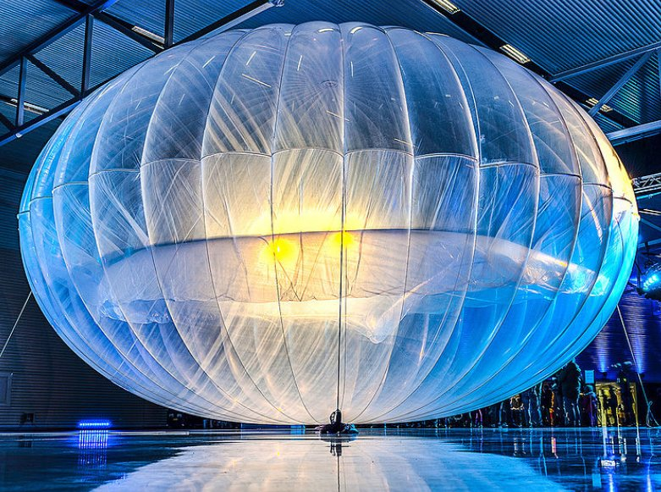

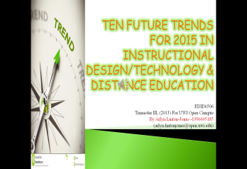
New Versions of Wifi
Balloon Enable Wifi-Project Loon- a network of balloons traveling on the edge of space, designed to connect people in rural and remote areas.
5G- Increase in higher data volume per area unit, lower battery consumption, better coverage,higher number of supported devices, lower infrastructure deployment costs, and higher reliability of communications.
http://www.google.com/loon/#utm_source=google&utm_medium=cpc&utm_campaign=Global_semBK
http://articles.economictimes.indiatimes.com/2013-11-30/news/44596333_1_bell-labs-lte-user-experience

Slide 3
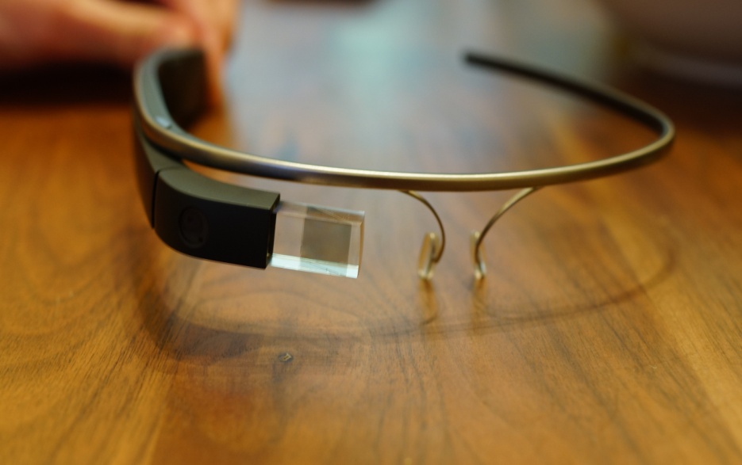
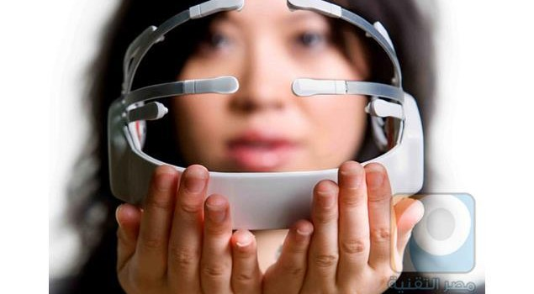

Wearable Technology
Wearable Technology are clothing and accessories incorporating computer and advanced electronic technologies.
Google Glass is a wearable computer with an optical head-mounted display .Google Glass displays information in hands-free format.
Mind Reading Headphones-are equipped with a sensor for forehead whose function is to analyze the brain waves in order to detect user’s mood. Then connects to the Mico database with help of the iPhone application.
http://www.google.com/glass/start/
http://www.wearabledevices.com/what-is-a-wearable-device/
http://wonderfulengineering.com/mind-reading-headphones-play-music-based-on-your-mood/

Slide 4
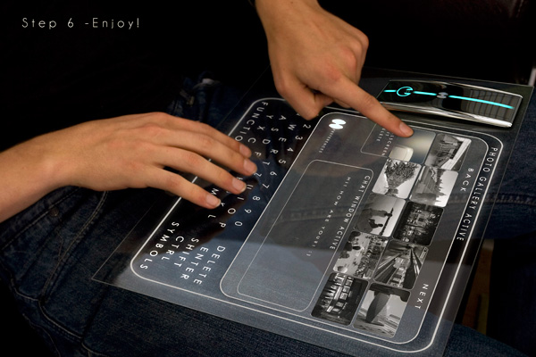
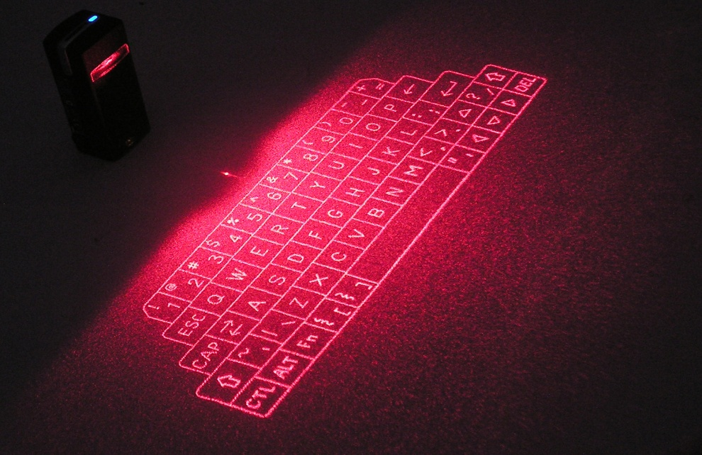


Holographic Technology
Computer Generated Holography is the method of digitally generating holographic interference patterns. This display could produce video images 30 times a second, which is deemed fast enough to produce the illusion of motion.
Hologram Computer & Virtual Keyboard
http://www.virtual-laser-devices.com/
http://www.dvice.com/2013-6-26/holographic-tv-might-be-closer-you-think

Slide 5
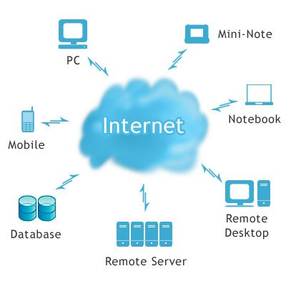
Cloud Based Learning
Cloud Based Computing -It uses the internet as a resource, and as a gateway to the offering of computing services.The cloud offers access to all of your data, all of the time and supports simpler and more compelling curation of digital work in pursuit of digital portfolios.
Cloud Based Classes & Cloud Based Learning Engines
http://www.technologyreview.com/news/420305/Google-offers-cloud-based-learning-engine/
http://www.teachthought.com/technology/4-benefits-to-cloud-based-learning/

Slide 6
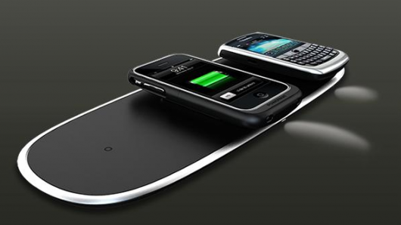

Wireless Charging Technology
Wireless Charging Technology facilitates the transmission of electrical energy from a power source to an electrical load without connecting wires. The technology is useful in cases where wires are hazardous, impossible to connect, or simply inconvenient.
Wireless Power
http://www.idt.com/products/power-management/wireless-power-transmitter-and-receiver-solutions

Slide 7
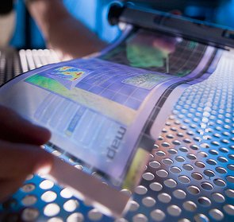
Flexible Display
Flexible Display –A display which is flexible in nature and can be applied to technology in e-readers, mobile phones and other consumer electronics .
Flexible Screens
http://news.cnet.com/8301-1035_3-57607171-94/what-you-should-know-about-flexible-displays-faq/

Slide 8
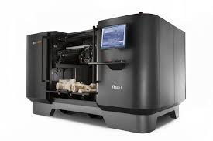

3D Technology
3D Printing –A process of making a three-dimensional solid object of virtually any shape from a digital model where successive layers of material are laid down in different shapes.
3D Photography
http://digital-photography-school.com/photo-magic-3d-photography
http://www.battelle.org/our-work/consumer-industrial/product-process-development/3d-printing-rapid-prototyping?gclid=CPjQkMiDk7sCFYZi7Aod-G0APA

Slide 9
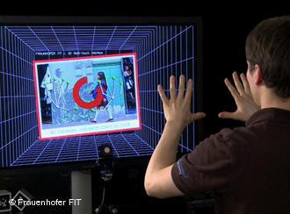
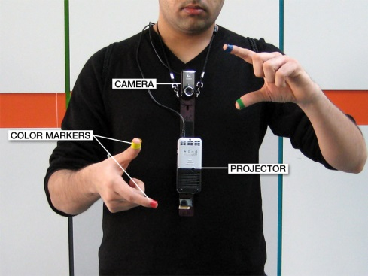
Gesture Based Computing
Gesture-Based Computing allows users to engage in virtual activities with motions and movements similar to what they would use in the real world.
SixthSense-a wearable gesture interface that lets the user navigate a map displayed on a nearby surface using hand gestures.
http://www.pranavmistry.com/projects/sixthsense/
http://k12.wiki.nmc.org/Gesture-Based+Computing

Slide 10

Real Time Voice Translation
Translate Your World-A global voice translation system for business that instantly converts what people say into and out of 23 spoken languages in real-time.
Multilingual Mobile & On the Fly Translation
http://www.prweb.com/releases/2013/9/prweb11159534.htm

Slide 11
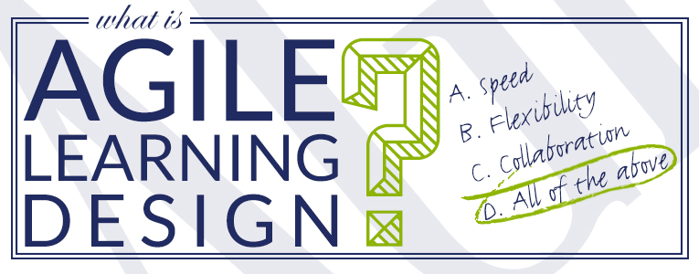
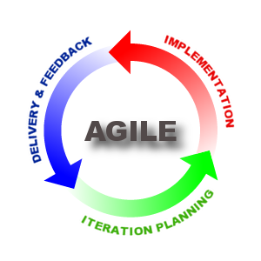
Agile Learning Design Process
Agile Learning Design -By using collaborative teams and constant iterations and feedback, you end up with a faster and more flexible (aka: agile) process that arrives at more innovative solutions.
http://www.bottomlineperformance.com/what-is-agile-learning-design/

Slide 12

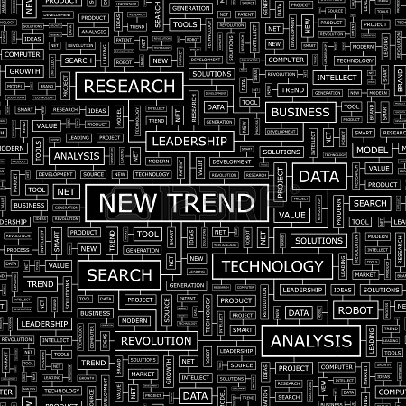
THANK YOU
THE END

